Slide 1


Using Data Mining to improve business in
Car Rental chain
CSN-515: Data Mining
Presented by-
Devansh Joshi
Divyansh Agarwal
Aishwarya
Aditya Rai
Anikait Agrawal
Mayank Meena
(19114026)
(19115055)
(19114005)
(19114004)
(19114008)
(19114055)

Slide 2
Table of Contents
Problem Statement ………………………………………………………………………………. 3
Dataset …………………………………………………………………………………………………… 4
Data Preparation …………………………………………………………………………………… 6
Data Mining Techniques used ………………………………………………………………. 7
K-Means Clustering Analysis ………………………………………………………………. 8
Association Rule Mining ………………………………………………………………………. 16
Regression ……………………………………………………………………………………………… 18
Conclusion ……………………………………………………………………………………………….23

Slide 3
Problem Statement
Car rental chains rent fleet of vehicles to consumers for a set amount of time depending on their needs
Car rental industry - highly competitive
Need to focus on inventory management, cost optimization, customer insights,
Role of Data Mining -
Analyze customer data Identify Relationships and Patterns affecting rental rates
Generate recommendation to improve business process (optimizing cost management etc)

Slide 4
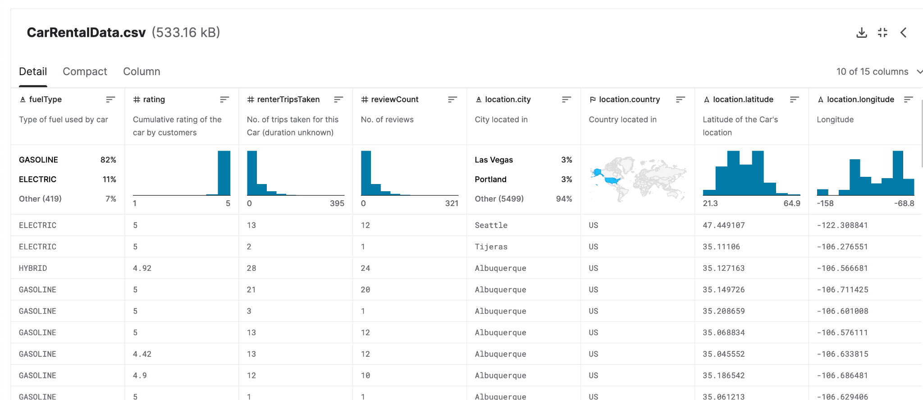
Dataset: Cornell Car Rental Dataset

Slide 5
Dataset: Cornell Car Rental Dataset
The "Cornell Car Rental Dataset" created by Kushlesh Kumar is a dataset on Kaggle that contains information on car rentals from a car rental company based in New York City. The dataset includes data on the rental reservation, the customer, the car rented, and the rental period.
The dataset provides information on the rental reservation, such as the Reservation ID, Rental Company, Rental City, and Rental State. Additionally, it contains information on the car rented, such as the Car Model, Car Make, Car Type, and Rental Price.
The "Cornell Car Rental Dataset" can be used for various purposes, including analyzing car rental trends, customer behavior, and pricing strategies. It can also be used to develop machine learning models to predict rental demand, customer preferences, or rental costs.

Slide 6
Data preparation
Data Cleaning and preprocessing.
Handling missing data:- dropping the missing data/ taking mean.
Feature selection ( Attribute Subset Selection)
Transformation / Normalization .

Slide 7
Data mining techniques used
K-means clustering
Association Rule Mining
Regression analysis

Slide 8
K-Means Clustering Analysis
The attributes "rating," "rate.daily," "renterTripsTaken," "reviewCount," "vehicleTypeNormalized," "fuelNormalized," and "locationNormalized" have been used to cluster the dataset.
Grouped the information into three clusters:
Cluster 0 : 4212 vehicles, Cluster 1: 799 vehicles, Cluster 2 : 840 vehicles
Vehicles of cluster 2 gets rented out more frequently compared to others.

Slide 9
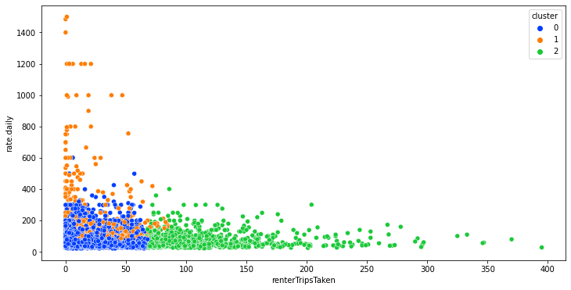

Slide 10
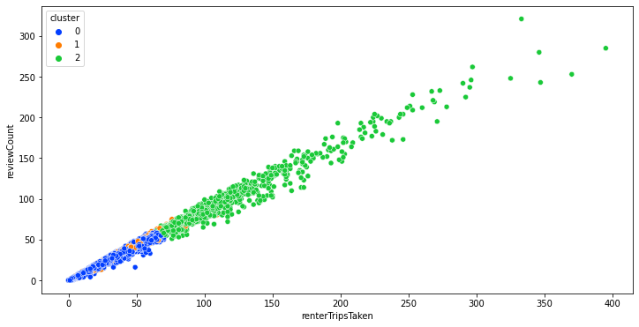

Slide 11
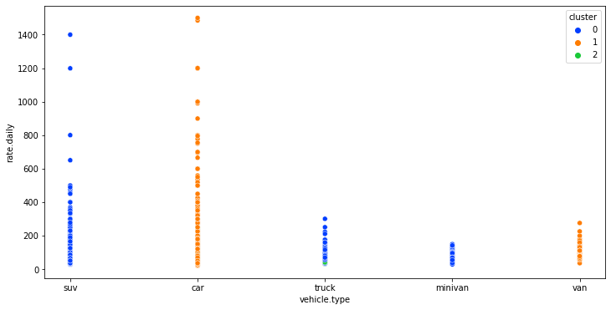

Slide 12
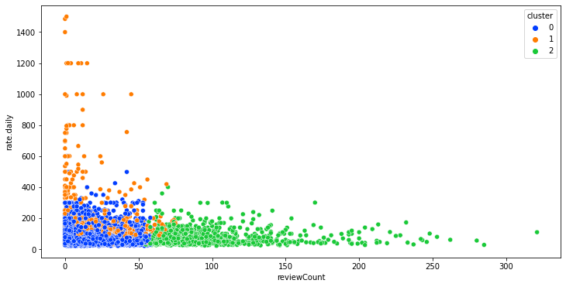

Slide 13
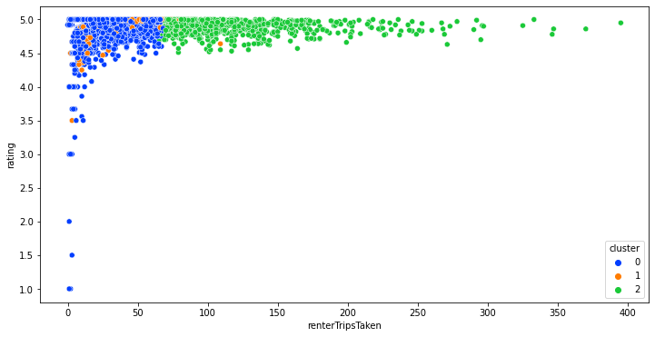

Slide 14
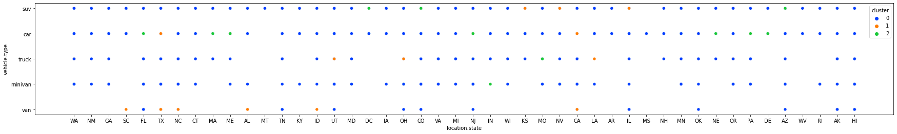

Slide 15
Business Insights Obtained

Slide 16
Insights using K-means clustering
Vehicles of one cluster found to be hired frequently leading to more number of trips taken
Will lead to more number of reviews, creating an inequitable demand and supply of vehicles
Dynamic pricing approach can be used to prevent positive feedback loop
Helps diversify the revenue generation from all types of vehicles
Vehicle type vs state plot can also help to optimize the inventory management

Slide 17
Association Rule Mining
Utilised to determine rule between rental location and vehicle type.
Also discovered the rule with city as antecedents and vehicle model as consequents.
The Apriori algorithm is employed.
Used to make informed business judgements in the respective cities.

Slide 18
Business Insights Obtained

Slide 19
Insights Using Association Rule Mining
Dataset’s association rules produced can help in enhancing business operations such as -
Marketing and advertising using the relationship between city and brand of vehicles hired
Price and Revenue management
Fleet management

Slide 20
Regression
The Linear Regression model was trained to predict rental costs.
The attributes are vehicle type, fuel type, rating, location, review count, and renter trip history.
Achieved msme of 4150.

Slide 21
Business Insights Obtained

Slide 22
Insights using Regression Analysis
Best rental fares for different kinds of car can be found using the different attributes.
Effect of different individual attributes on the rental rates can be determined by examining their coefficients.
This information can help to determine optimal pricing of the cars accordingly.

Slide 23
Conclusion
Insights obtained via data mining can help to make more informed decisions
Helps in improving business operations, such as optimizing prices, managing inventory and anticipating business problems.
Can lead to a boost in their profitability and can help them to stay competitive in the market too

Slide 24
Thank You

